Slide 1
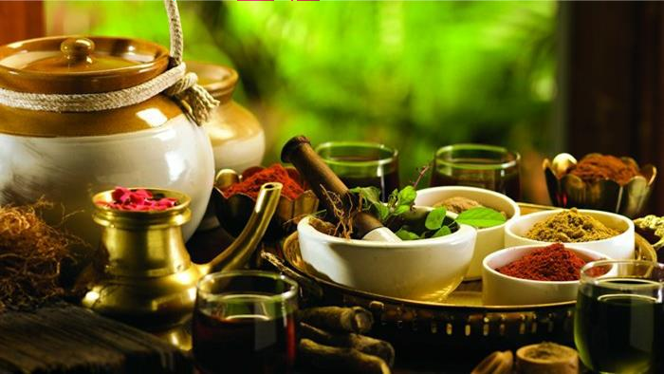
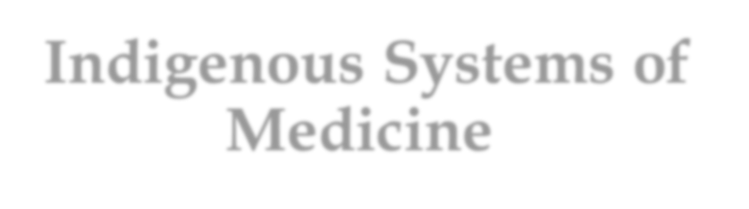

Indigenous Systems of Medicine

Slide 2


Introduction :
An indigenous system is a natural form of medicine outside the stream of Western or Allopathic medicine practiced by majority of doctors all over the world today.
These systems are Ayurveda , Siddha , Unani , Yoga
, Naturopathy, Sowa - Rigpa .

Slide 3
Ayurveda :
Ayurveda or ayurvedic medicine is one of the world's oldest holistic healing system.
The term "Ayurveda" is derived from two Sanskrit words , Ayur and Veda .
'Ayur' means life & 'Veda' means Knowledge or science .
Originated in India more than 5,000 years ago & is known as "Mother of All Healing".
Originates from ancient Vedic Culture & was taught for many thousands of years.

Slide 4

History :
The sacred 'Rigveda' describes 67 medicinal plants.
'Yajur Veda' mentions 81 species , 'Atharvaveda' describes 290 species &
114 hymns related to formulations for the treatment of
different diseases from 4500 - 2500 BC .
The first recorded treatise on Ayurveda during 700 BC describes properties &
uses of 1,106 plants .
'Sushruta
Samhita' during 800 BC explained different characteristics of fundamental
principles & theory of surgery & description of about 1,270 plants & 650 drugs .

Slide 5
Basic Principles of Ayurveda :
The principle of Ayurveda is based on the concept of 'Five Elements & Tridoshas '.
According to Ayurveda , the whole universe made up of five basic elements are –
Akash (ether) , Vayu (air) , Agni (fire) ,Jal (water) , Prithvi (earth).
'Pancha Bhutas' are represented in human body as the Doshas , Dhatus & Malas .
Three doshas in the body are Vata , Pitta & Kapha & are known as Tridoshas .
1) The Tri Gunas : 3 fundamental universal energies are Satva , Rajas & Tanas .
2) The Pancha Mahabhutas : 5 basic elements are Akasha , Vayu , Agni , Jala &
Prithvi .
3) The TriDoshas : 3 Body Humours are Vata , Pitta & Kapha .
Cont...

Slide 6
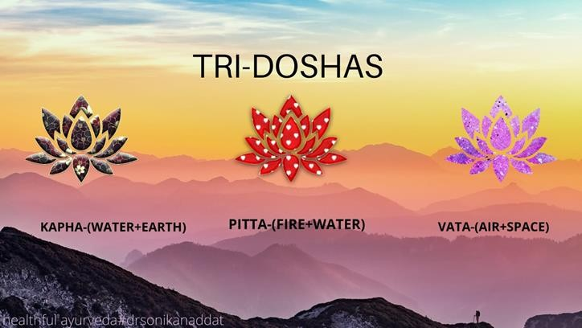
The Sapta Dhatus : 7 types of body tissues are – Rasa Dhatu , Mamsa
Dhatu , Meda Dhatu , Ashti Dhatu , Majja Dhatu , Sukra Dhattu .
The Trayodosa Agni : 3 types of digestive fires are Purisa (faeces) , Mutra (urine) & Sveda (sweat).

Slide 7

Diagnosis :
Disease is a reaction between doshas & dhatus & is also influenced by the environment.
The traditional clinical examination in Ayurveda ,known as Ashta Sthana Pariksha , includes an assesment of state of the doshas as well as various physical signs .
The 8 point diagnosis are Shabda Pariksha , Jilwa Pariksha , Mala Pariksha , Kapha or Akriti , Pitta or Drik , Vata or Sparsha , Mutra Pariksha , Nadi Pariksha .
Therapy often begins with shodhana (cleansing) in which toxins are eliminated . Once shodhana is completed , shaman(palliative) used to reduce the intensity of a disease & balance the disordered doshas. Finally,rasayana (rejuvention therapy) used to maintain health & reduce the negative effects of diseases.

Slide 8
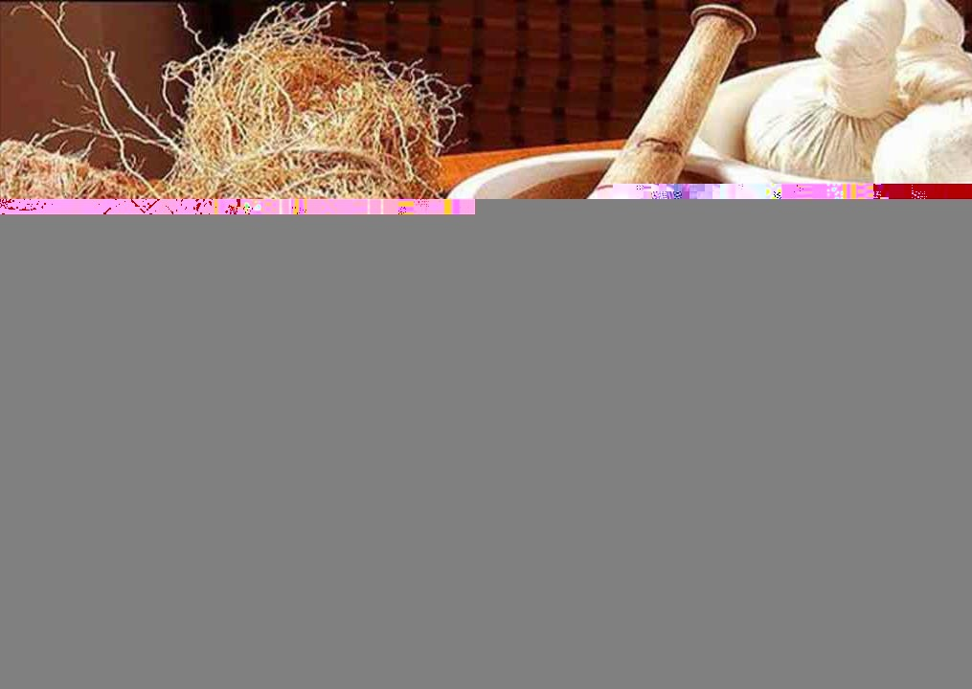

Siddha :
Siddha is one of the oldest & most basic traditional systems of medicine.
Practiced in the state of Tamil Nadu.
It is an ancient science , which belongs to Dravidian Culture.
-Siddha system insists the
scientific mode of life . Its preliminary aim is prevention & preservation of health .

Slide 9
Principles :
It also classifies physiological components of human beings as Vatha , Pitha & Kapha , like ayurveda.
These medicines recognise predominance of vatham , pritham & kapam.
Different physiological & psycological functions of the body occur due to the
combination of 7 elements: First is Saram(plasma) responsible for growth,development & nourishment
2 is Cheneer(blood) responsible for nourishing muscles ,imparting colour
3 is Ooun(muscle) responsible for shape of the body
- Fourth is Kollzuppu (fatty tissue)responsible for oil balance & lubricating joints
Fifth is Enbu(bone) responsible for body structure & posture
Sixth is Moolai(nerve) responsible for strength
7 is Sukila(semen) responsible for reproduction.

Slide 10
Diagnosis :
Examination of 8 items commonly as astasthana-pariksa is required in diagnosis.
1) Na(tongue)-Tongue will be yellow in pitha, white in kapha &black in vatha.
2)Varna(colour)-Colour will be dark in vatha, yellow or red in pitha & pale in kapha.
3)Svara(voice)-Voice will be normal in vatha , highly pitched in pitha , low pitched in kapha& slurred in alcoholism.
4)Kan(eyes)-Eyes will be muddy conjunctive , yellowish or red in pitha & pale in kapha.
5)Sparisam(touch)-Touch will be dry in vatha , warm in pitha , chill in kapha & sweating in different parts of the body.
6)Mala(stool)-Black stools indicate vatha ,yellow pitha, pale in kapha ,dark red in ulcer & shiny in terminal illness.
7)Neer(urine)-Early morning urine is examined ; straw colour indicates indigestion , reddish
yellow excessive heat, rose in blood pressure, saffron colour in jaundice & looks like meat washed water in renal disease.
8)Nadi(Pulse)-Confimatory method recorded on the radial artery.

Slide 11
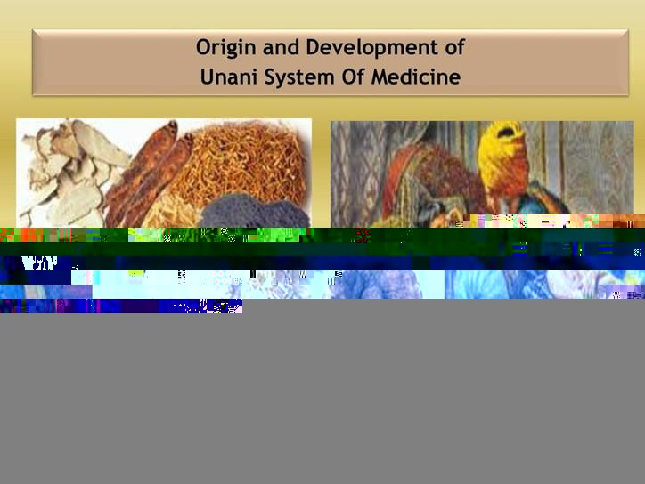
Unani :
Also called as 'Unani tibb ,Arabian medicine or Islamic medicine'.
of Unani Medicine are found in the doctorines
Origins
of the ancient Greek
physicians Hippocrates & Galen.

Slide 12
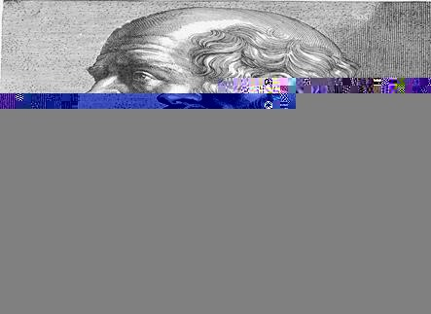
Origin:
Unani system originated in Greece.
The teachings of Greek physicians Hippocrates & Galen form the basis of theoretical framework of Unani medicine.
Unani name is derived from the word 'Ionian' .

Slide 13
Principles:
Based on Humoral Theory.
There are four humours in body :
1) Dam(Blood) : A coagulated portion forms a red mass. 2)Balghem(Phlegm) : The whitish egg yolk like matter. 3)Safra(Bile) :The yellowish froth on upper surface . 4)Sauda(Black Bile) : The blackish sediments at the bottom . Concept of Tabiyat :
Ultimate power of the body.
It tunes the body to stay in a healthy condition.
Power of influence to repair & come out of disease condition.
Continued....

Slide 14







In Unani Medicine , there are 6 factors
, essential for maintenance of
good health called 'Asbab-e-Sittah Zaruriah'-
1) Hawa-e-Muheet(Fresh Air)
2)Makool-o-Mashroob(Food&Drink)
3)Harkat-wa-Sukoon-e-Badania(Body
movement& Repose)
4)Harkat-wa-Sukoon-e-Nafsania(Mental
movement)
5)Naum-o-Yaqzah(Sleep &Wakefulness)
6)Ehibas-o-
Istafraagh(Retention&Evacuation)

Slide 15
-In Unani system , human body is based on 7 natural principles known as “Umure Tabiya” which is
existence of human body.
-Loss of anyone components could lead to deadth - 1)Element(Arkan)
Temperament(Mizaj)
Humours(Akhlat) 4)Organs(Aza)
5)Pneuma or Vital Spirit(Arwah) 6)Faculties of Power(Quwa) 7)Function(Al-Afal)
-Every individual has an inherent power of self-preservation called the “Quwwat-e-Modabbira”.

Slide 16
Diagnosis :
-Examination of Pulse(Nabz)
-Examination of Urine(Baul)
-Examination of Stool(Baraz)
-Drugs made from medicinal plants,herbs,minerals,metallic & animal origin are used for the treatment of diseases.

Slide 17
-Modes of treatment :
-Treatment is divided into four parts :
Ilaj-Bil-Ghiza(Dietotherapy)-Treatment through diet.
Ilaj-Bil-Tadbeer(Regimental Therapy)-Treatment through certain
procedures , tools & equipments.
Ilaj-Bil-Dawa(Pharmacotherapy)-Treatment through drugs/medicines , which are of Plant, Mineral or Animal Origin.
Ilaj-Bil-Yad(Surgery)-Treatment through Minor/Major Operative
Procedures.

Slide 18
Thank You

